Slide 1
Team 2
BOOK RECOMMENDATION SYSTEM
Team Members
Chaitrali Ravindra Kale
Mr. Suraj Kiran Pandkar
Ms. Reethu T V
Mr. Surya Prakash Mangam
Ms. Pratima Rajendra Pawar
Ms. Jasmeet kaur
Ms. Megha V K

Slide 2

Table of content
Problem statement
Data Summary
Data Cleaning
Recommendation Model
Conclusion
Future Scope

Slide 3

Problem Statement
Recommendation systems, seen on sites such as Amazon and YouTube, provide individualized suggestions, saving time and decreasing overload. They increase engagement, boost sales, and offer decision help across domains, so improving user experiences and adding value to digital interactions.
Our primary objective is to develop a recommendation system that suggests appropriate books to consumers based on popularity.

Slide 4
Data Summary
The dataset is comprised of three csv files:: User, Books, Ratings
Users_dataset.
User-ID (unique for each user)
Location (contains city, state and country separated by commas)
Age Shape of Dataset - (278858, 3)
Books_dataset.
ISBN (unique for each book)
Book-Title
Book-Author
Year-Of-Publication
Publisher
Image-URL-S
Image-URL-M
Image-URL-L
Shape of Dataset - (271360, 8)
Ratings_dataset.
User-ID
ISBN
Book-Rating
Shape of Dataset - (1149780, 3)

Slide 5
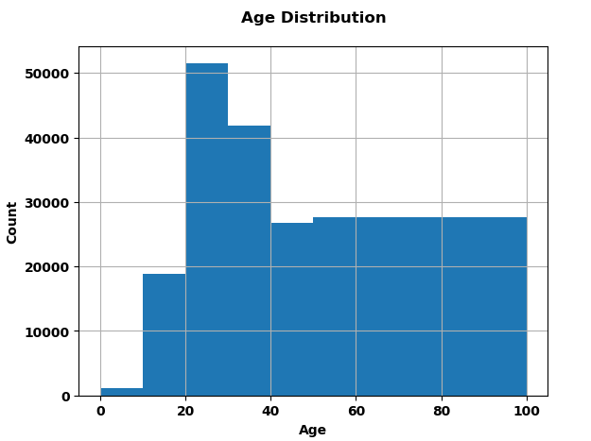
Exploratory Data Analysis (User Dataset)
●Age in the dataset ranges from 0 To 100.
●Most of the users are of age 20-35 years.

Slide 6
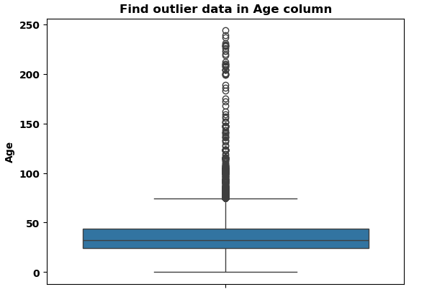
Exploratory Data Analysis (User Dataset)
Outliers in Age column
Age has positive Skewness (right tail) so we can use median to fill Nan values.

Slide 7
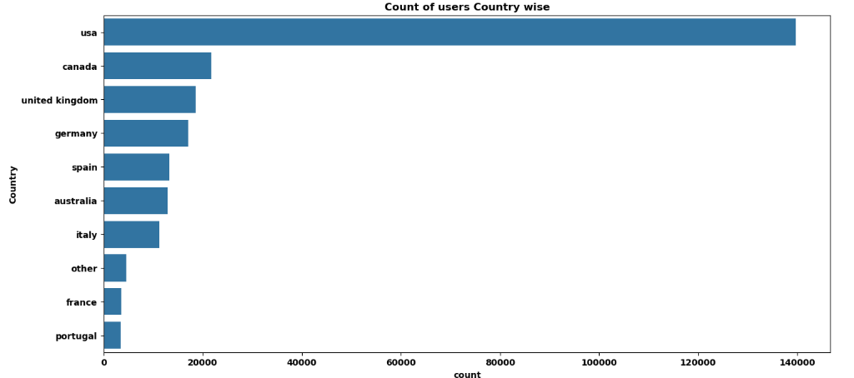
Checking distribution of Location feature:
Splitting Location column and analysing country.
Most active readers are from USA.

Slide 8
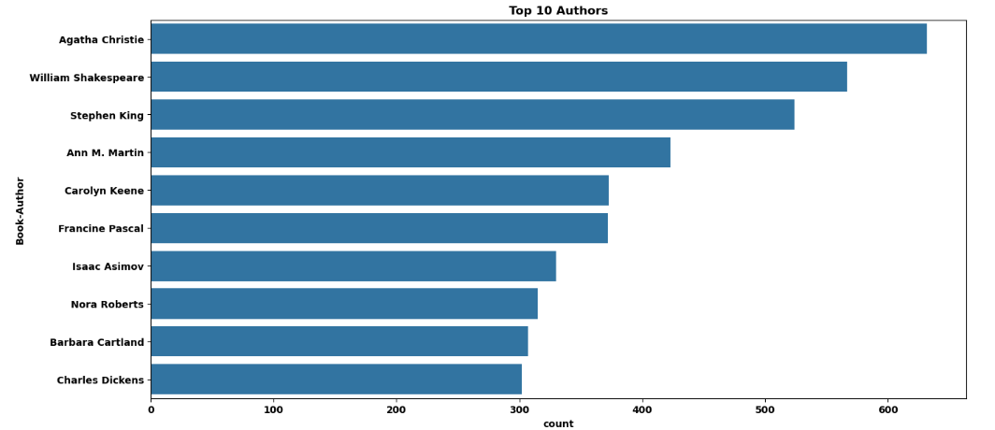
Exploratory Data Analysis (Books Dataset)
Top 10 Authors which have written the most books:
Agatha Christie wrote highest number of books in our given dataset

Slide 9
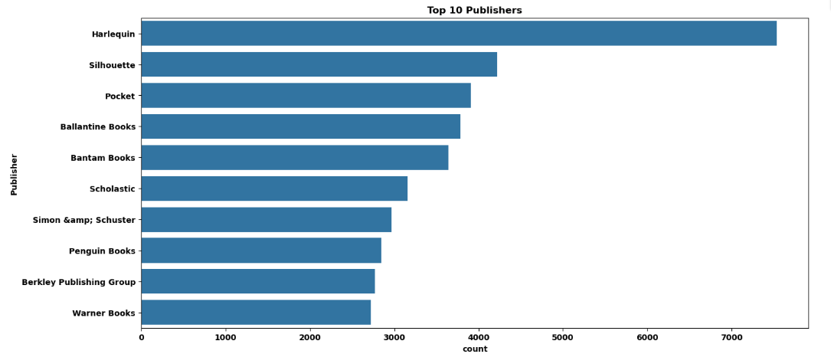
Top 10 Publisher which have published the most books:
Harlequin published highest number of books in our given dataset

Slide 10
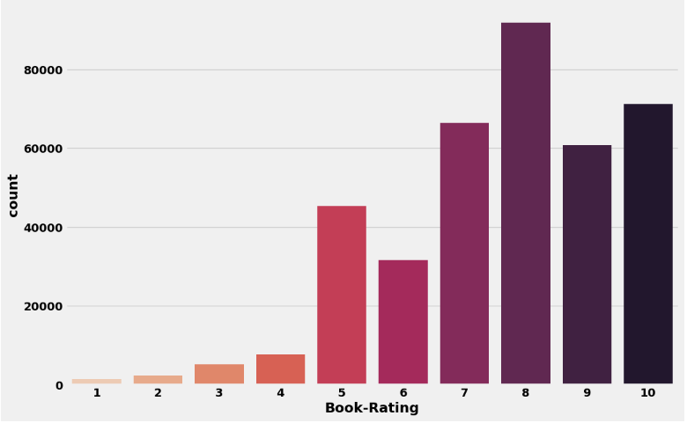
Exploratory Data Analysis (Ratings Dataset)
Higher ratings are more common amongst users
Rating 8 has been rated the highest number of times

Slide 11
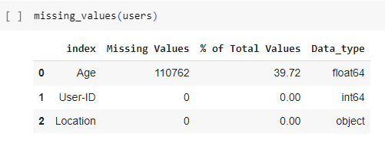
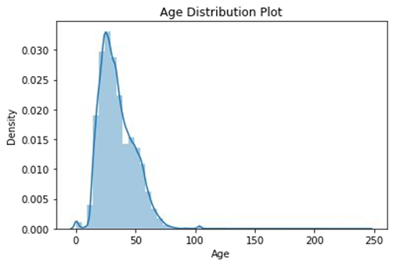
Data Cleaning
●Age column has 40% missing values.
●Age has positive Skewness (right tail) so we can use median to ﬁll Nan values, but for this we don't like to ﬁll Nan value just for one range of age. To handle this we'll use country column to ﬁll Nan.
●As we all knew already that Age value's below 5 and above 100 do not make much sense as the can't read/rated our book so we can replace that.

Slide 12
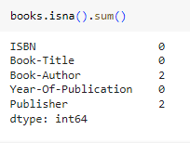


Data Cleaning
Null Value Imputation:

Slide 13
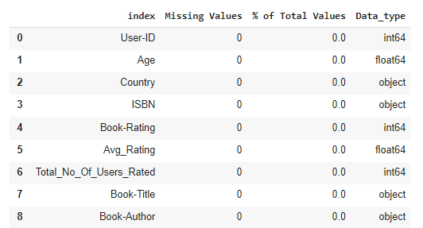

Merging All the three Datasets
Merging all the three datasets i.e Books, Users, Ratings dataset.
Rechecking Missing Values in the ﬁnal dataset.
Checking Shape of the ﬁnal dataset.

Slide 14
Recommendation Models

Slide 15

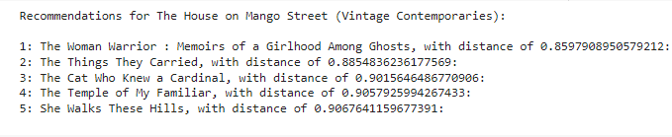
Collaborative Filtering-(Item-Item based)

Slide 16
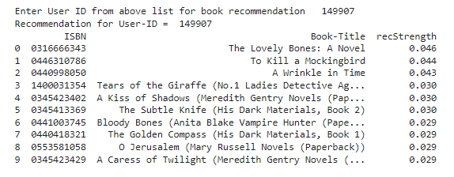
Collaborative Filtering-User-Item based

Slide 17
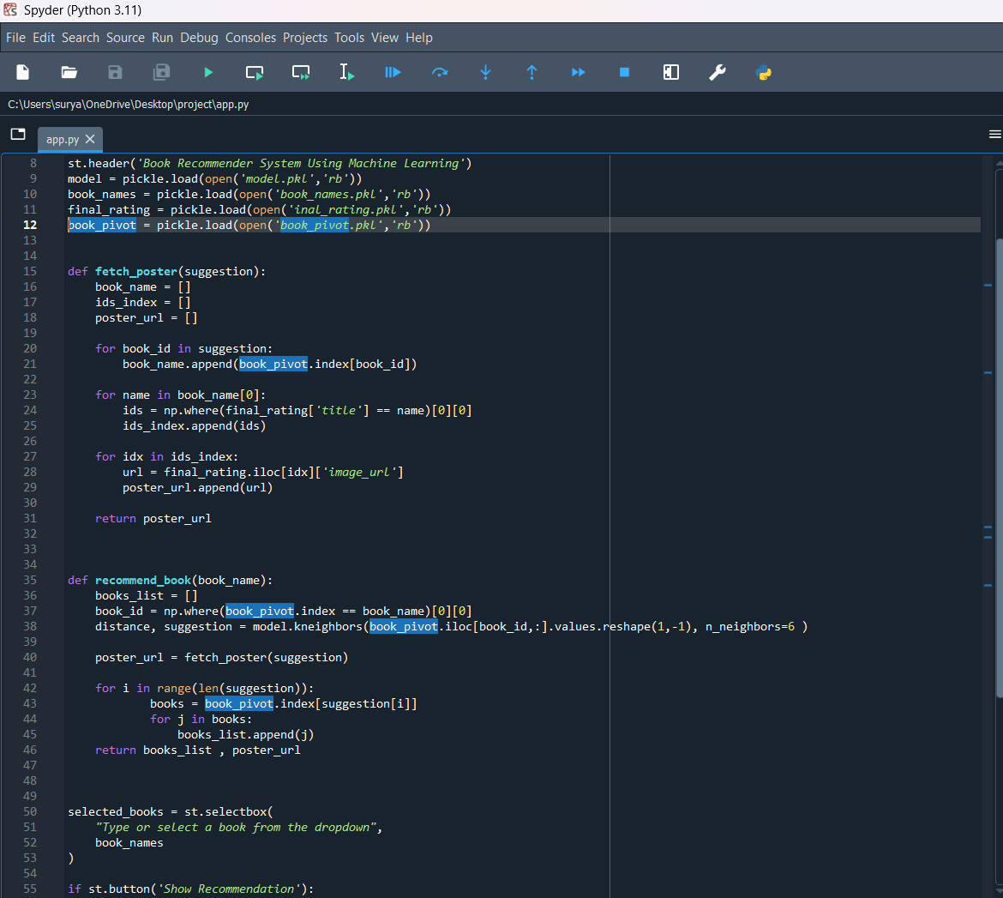
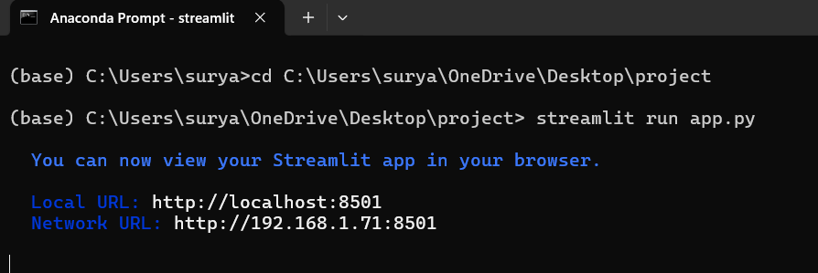
Deployment
For deployment process we have used “streamlit” module and developed the code in spyder application.
To run the code we have to open Anaconda prompt and change the current directory to where the file located.
Then run the command “streamlit run 'filename.py’ (here in this case filename is app.py) ”

Slide 18
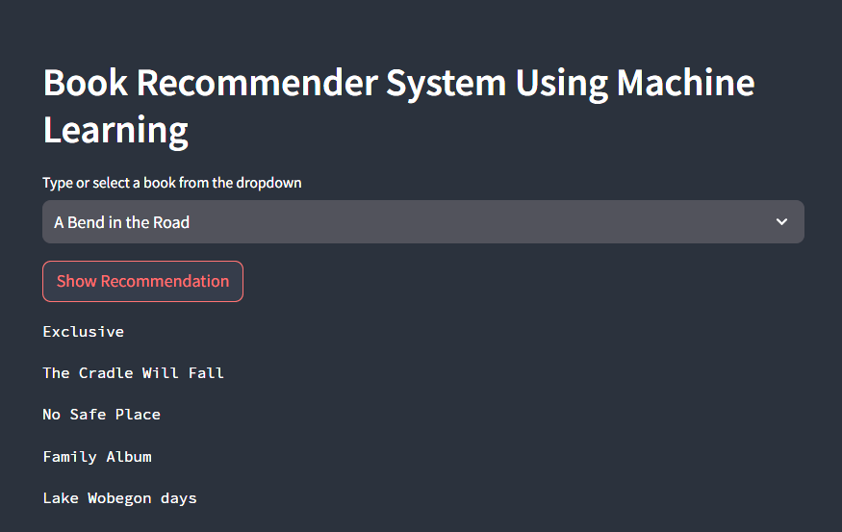
Deployment
The prompt opens the default browser, display us a input select box and a button for recommending the books.
When we select the preferred book name and press show recommendation button, it displays the book covers.

Slide 19
Conclusion
With exploratory data analysis (EDA), the top ten most-rated books were mostly novels, such as "The Lovely Bones" and "The Secret Life of Bees," which were well-regarded.
Most readers were between 20 and 35 and came mostly from North American and European nations such as the United States, Canada, the UK, Germany, and Spain.
When the ratings distribution was examined, most novels earned high ratings, with the majority receiving an 8. Books with ratings under 5 were uncommon. The three authors with the most novels published were Stephen King, William Shakespeare, and Agatha Christie.

Slide 20
Conclusion
A recommendation system helps firms develop consumer loyalty. Today's recommendation algorithms are incredibly powerful, capable of serving not just current consumers but also first-time visitors to the site. These algorithms expertly propose things that are currently popular or highly regarded, as well as those that will increase the company’s earnings.

Slide 21
Future Scope
Given more information regarding the books dataset, namely features like Genre, Description etc, we could implement a content-filtering based recommendation system and compare the results with the existing collaborative-filtering based system.
We would like to explore various clustering approaches for clustering the users based on Age, Location etc., and then implement voting algorithms to recommend items to the user depending on the cluster into which it belongs.

Slide 22
Thank You

